Slide 1

Measles vaccination impact in Kenya.
A dynaMICE modelling study
Stanley & Mutono

Slide 2
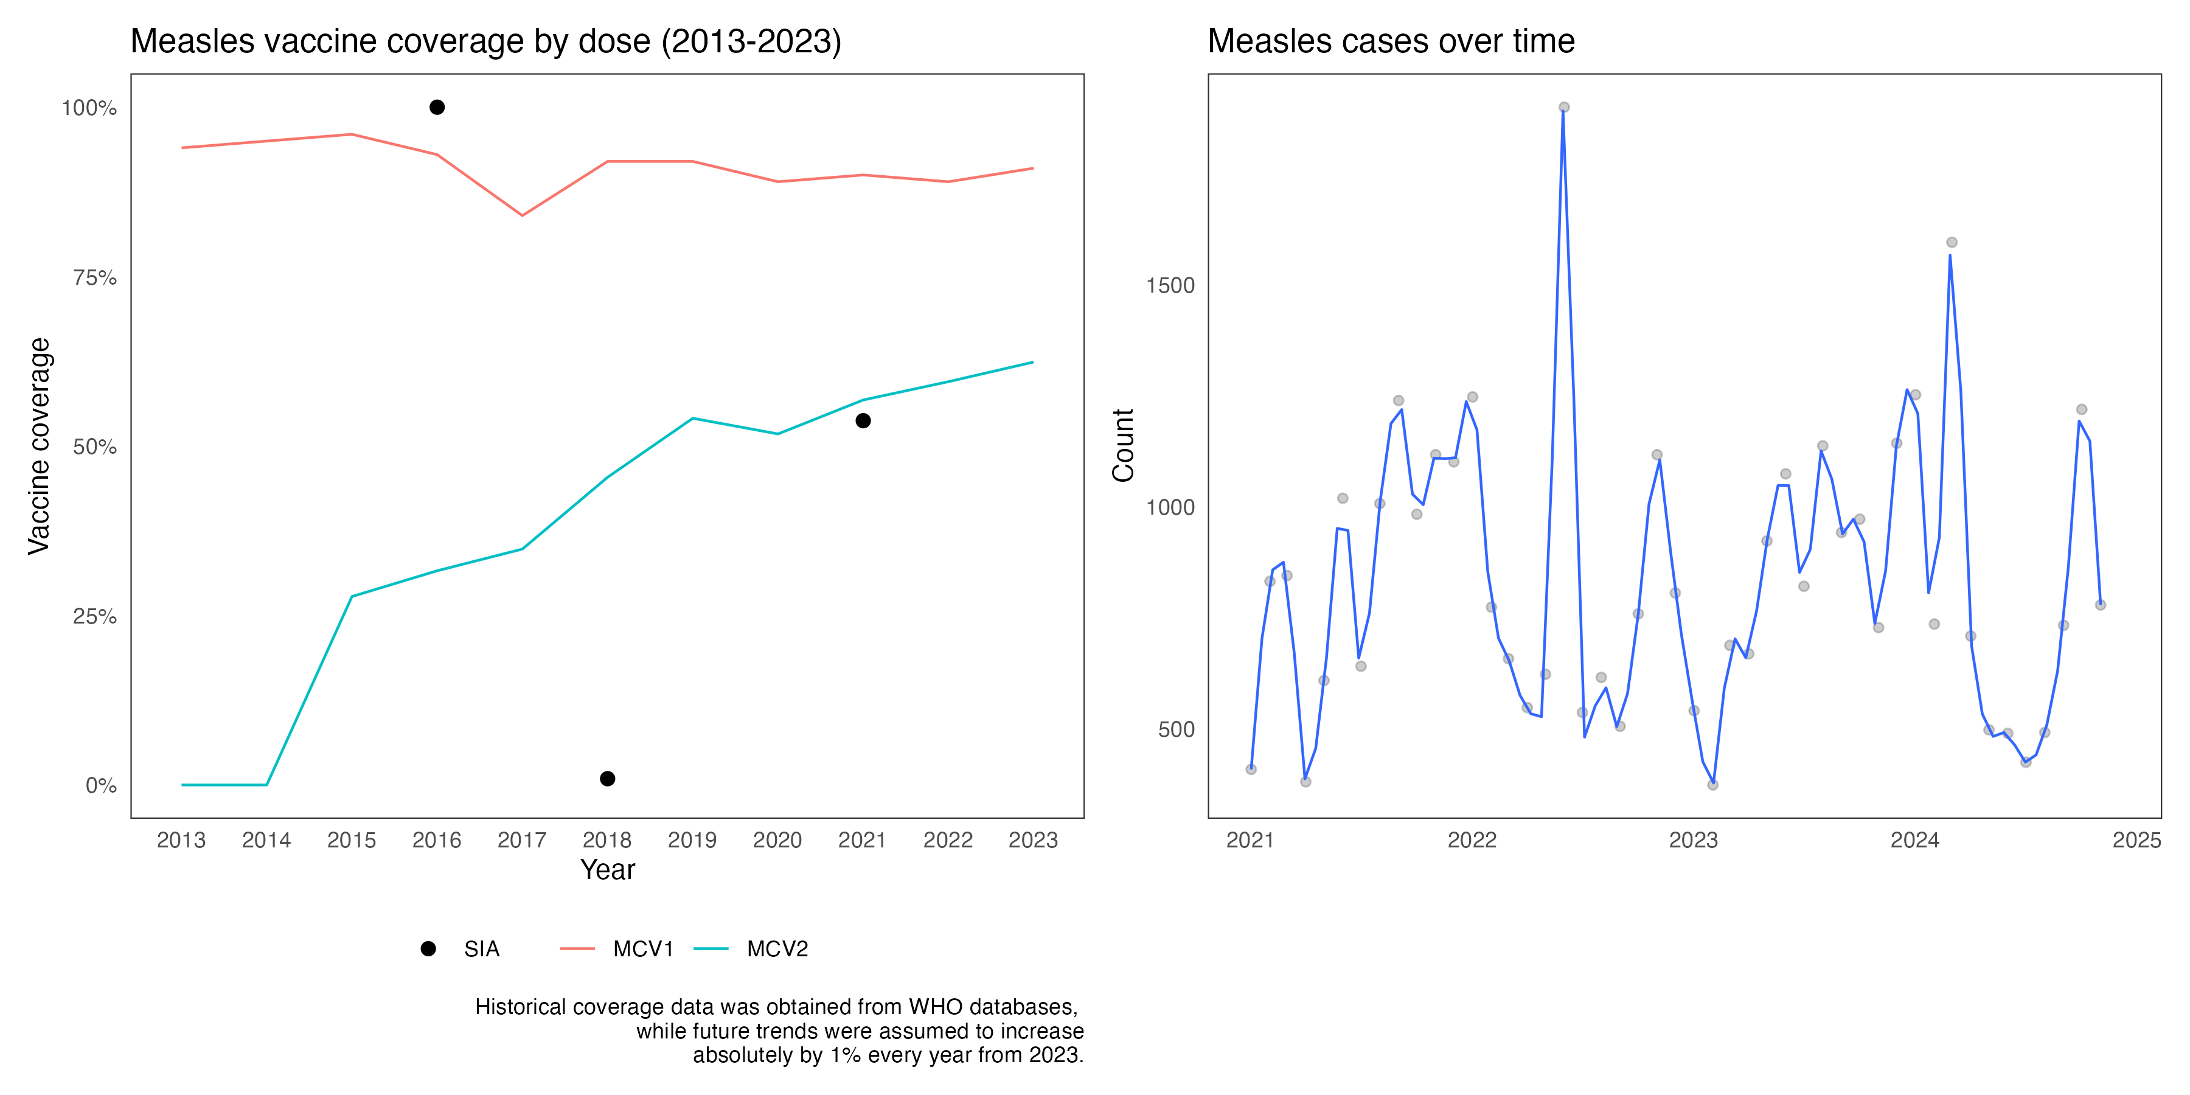
The National picture:
MCV1 Vaccination coverage has been high (above 75%).
MCV2 Coverage has been increasing rapidly in the country.
The immediate disruption to vaccine coverage by COVID-19 was minimal and negligible.
12 SIA have been conducted since 1994, mostly targetting 1-5 year olds, with high coverage in 4 of the SIAs
___
World Health Organization: Immunization data portal.
World Health Organization: Summary of Measles-Rubella Supplementary Immunization Activities, 2000-2020.
Kenya Health Information System, 2024. Accessed: Fri 13 Dec 2024

Slide 3
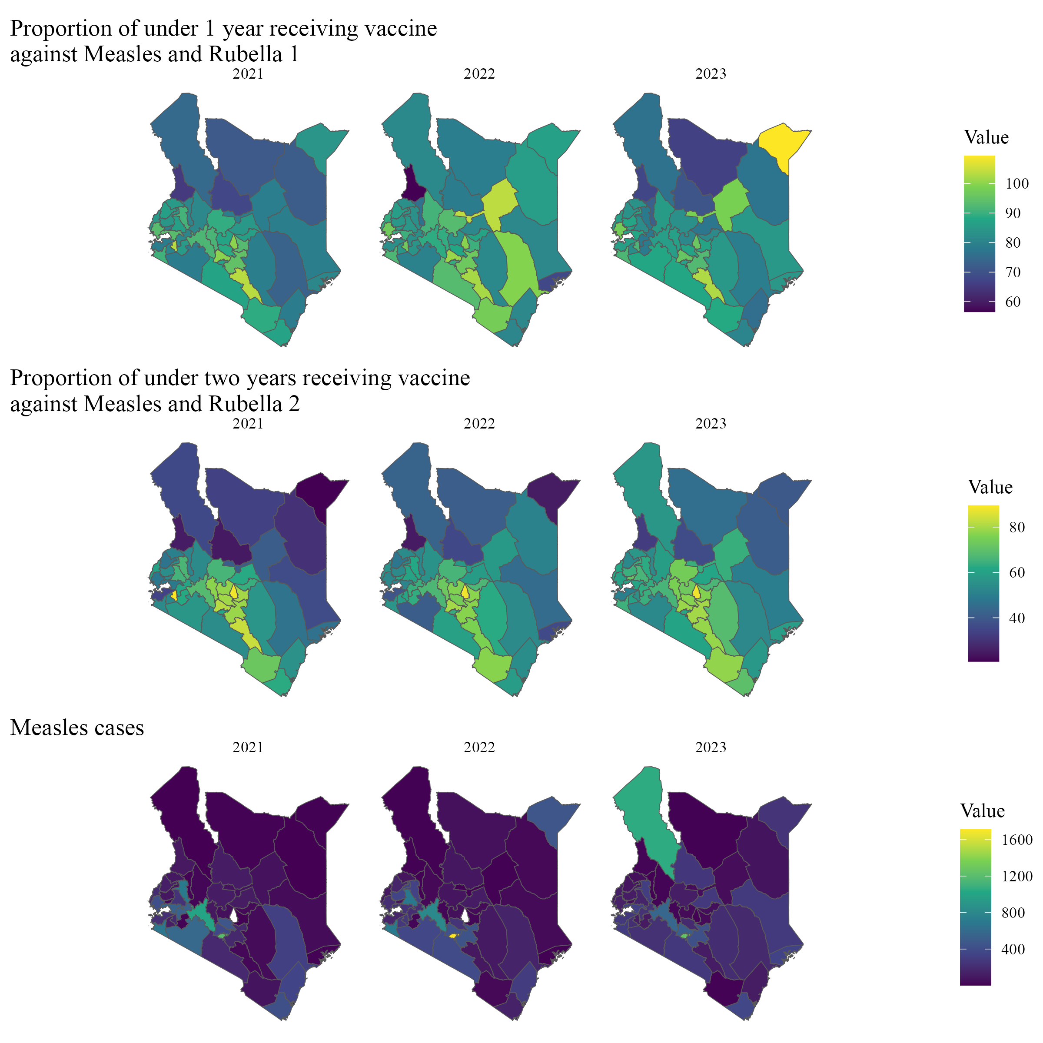
The sub-national picture:
MCV1 Vaccination coverage has been high across most counties.
MCV2 Coverage has been increasing rapidly in the country, with some having below 40% and others above 60%.
There is low measles incidence in the counties.
____
Kenya Health Information System, 2024. Accessed: Fri 13 Dec 2024

Slide 4
Objective:
To assess the effect of different vaccination strategies on measles burden (2013 – 2030):
We evaluate counterfactual scenarios, such as the absence of MCV vaccination and MCV1-only vaccination, quantifying the reduction in cases, deaths, and DALYs under the actual country scenario.
To model the effect of different determinants of MCV dynamics and their impacts on MCV burden (2013 – 2030):
We analyze the variability in outcomes based on different model inputs for estimating the measles burden.

Slide 5
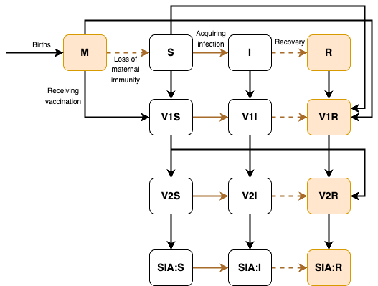
Model structure of DynaMICE for a single age stratum.
M-maternally immune, S-susceptible, I-infectious, R-recovered.
V1, V2,SIA: the received number of 1 / 2 / 3 and more vaccine doses, respectively.
Individuals with natural or vaccine-acquired immunity (orange shaded squares) are not susceptible to measles.
In this model, births only add to the youngest age group. For clarity of presentation, ageing and death are not shown.
Total age stratums: 254.
___
Fu H, Abbas K, Klepac P, et al. Effect of evidence updates on key determinants of measles vaccination impact: a DynaMICE modelling study in ten high-burden countries. BMC Med 2021; 19: 281.
Verguet S, Johri M, Morris SK, Gauvreau CL, Jha P, Jit M. Controlling measles using supplemental immunization activities: a mathematical model to inform optimal policy. Vaccine 2015; 33: 1291–96.
Auzenbergs, M., Fu, H., Abbas, K., Procter, S. R., Cutts, F. T., & Jit, M. (2023). Health effects of routine measles vaccination and supplementary immunisation activities in 14 high-burden countries: a Dynamic Measles Immunization Calculation Engine (DynaMICE) modelling study. The Lancet. Global health, 11(8), e1194–e1204. https://doi.org/10.1016/S2214-109X(23)00220-6

Slide 6
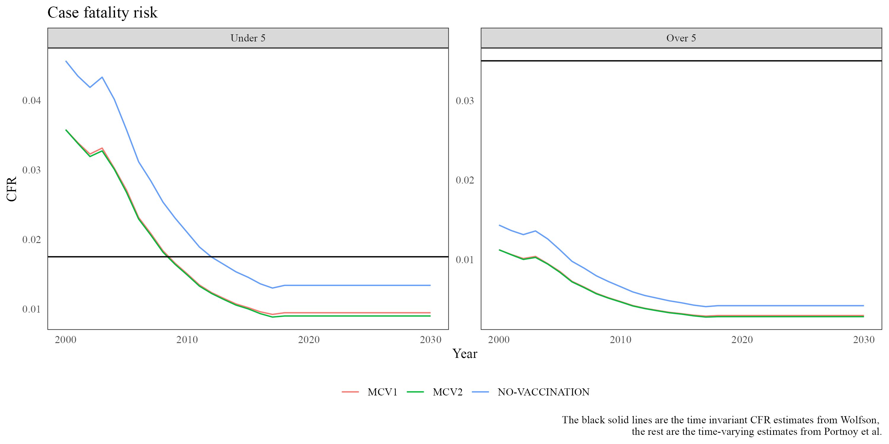
The determinants of MCV impact (I):
Case fatality risk:
Time-varying, age-dependent global CFR estimates based on a review of 124 articles
Contact patterns:
Contact matrices: Synthetic, POLYMOD, Uniform
Age-dependent vaccine efficacy:
Simple step change: 85% | 95%
Linear change w.r.t. age based on a systematic review of 33 articles on vaccine efficacy.
___
Portnoy A, Jit M, Ferrari M, Hanson M, Brenzel L, Verguet S. Estimates of case-fatality ratios of measles in low-income and middle-income countries: a systematic review and modelling analysis. Lancet Glob Health. 2019;7(4): e472–e81. https://doi.org/10.1016/S2214-109X(18)30537-0.

Slide 7
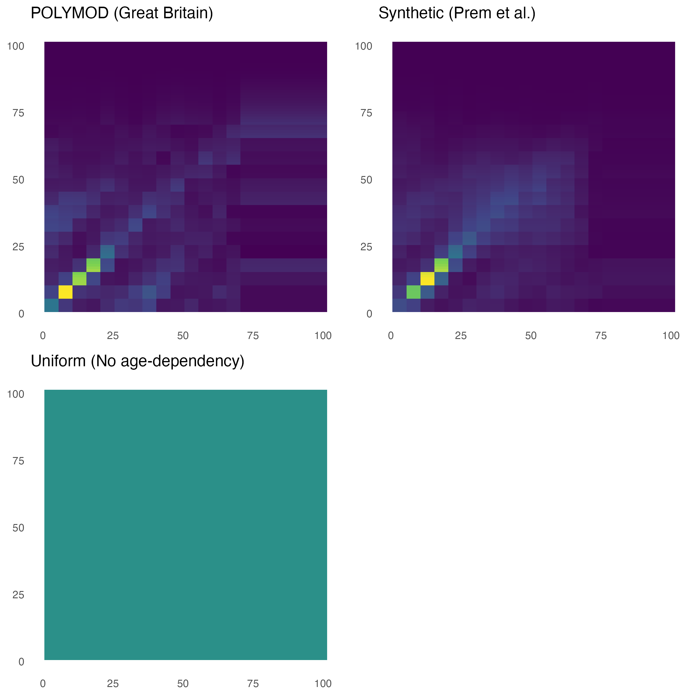
The determinants of MCV impact (II):
Case fatality risk:
Time-varying, age-dependent global CFR estimates based on a review of 124 articles
Contact patterns:
Contact matrices: Synthetic, POLYMOD, Uniform
Age-dependent vaccine efficacy:
Simple step change: 85% | 95%
Linear change w.r.t. age based on a systematic review of 33 articles on vaccine efficacy.
___
Prem K, Cook AR, Jit M. Projecting social contact matrices in 152 countries using contact surveys and demographic data. Plos Comput Biol. 2017;13(9): e1005697. https://doi.org/10.1371/journal.pcbi.1005697.

Slide 8
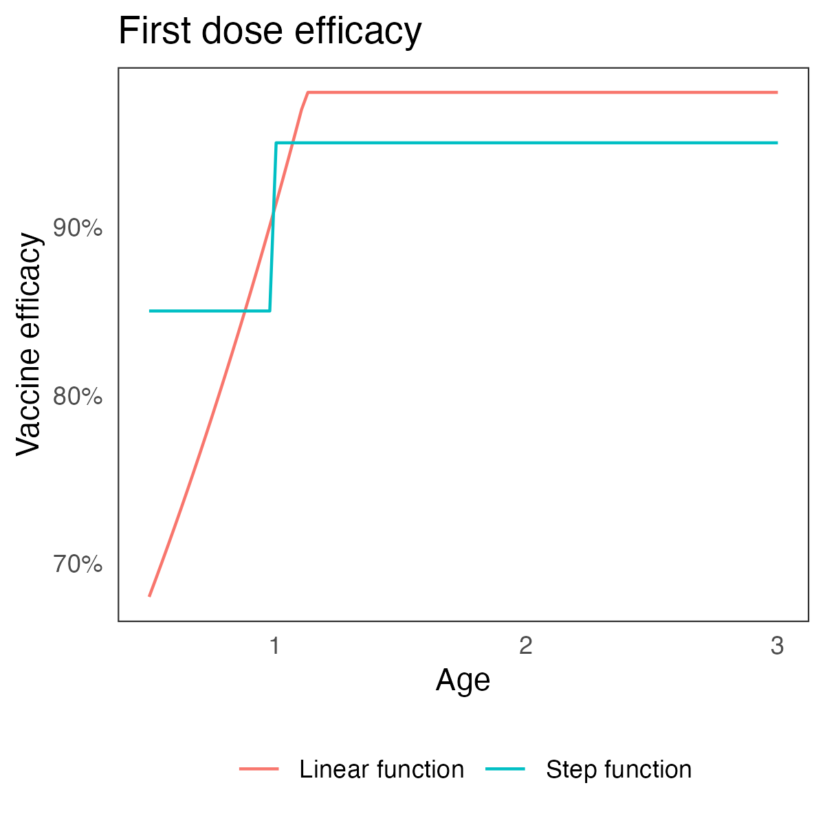
The determinants of MCV impact (III):
Case fatality risk:
Time-varying, age-dependent global CFR estimates based on a review of 124 articles
Contact patterns:
Contact matrices: Synthetic, POLYMOD, Uniform
Age-dependent vaccine efficacy:
Simple step change: 85% | 95%
Linear change w.r.t. age based on a systematic review of 33 articles on vaccine efficacy.
___
Hughes SL, Bolotin S, Khan S, Li Y, Johnson C, Friedman L, et al. The effect of time since measles vaccination and age at first dose on measles vaccine effectiveness - A systematic review. Vaccine. 2020;38(3):460–9. https://doi. org/10.1016/j.vaccine.2019.10.090.

Slide 9
Model assumptions:
Target Basic reproductive number fixed at 14.25
Vaccine efficacy is modelled as “all-or-nothing”
MCV1 is given at 9 months, and MCV2 is given at 12 months in line with who standards.
Maternal immunity lasts for first 6 months.
Recovery from measles leads to lifelong immunity.
___
The age structure is stratified into weekly age groups for first 3 years, and 1 year-groups for the rest.
Average duration of infectiousness is 14 days.
Vaccine coverage (MCV1 & MCV2) projected at absolute 1% increase from 2023-2050.
Seasonality of measles transmission is enforced.
Scenarios:
- No vaccinatons (the baseline)
- MCV1 Only
- MCV1 + MCV2
MCV Vaccination impact metrics:
New infections (incident cases)
Measles related deaths:
Deaths = CFR * Cases
Disability adjusted life years:
k * [Cases – Deaths] + [Deaths * Remaining Life Exp.]
(Disability weight) k = 0.002

Slide 10
Results
(National)

Slide 11
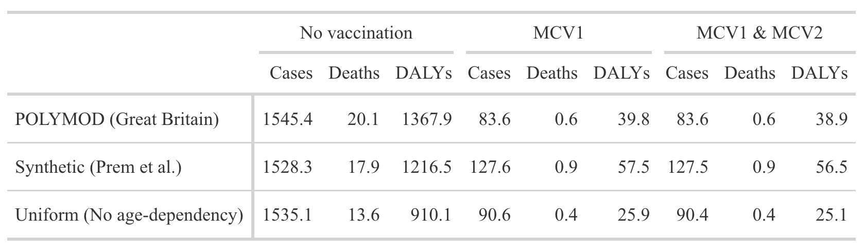
Average annual measles cases, deaths, and DALYs over 2013–2030 are presented per 1,000 population.
The statistics presented utilize: Linear Vaccine efficacy, and the Portnoy’s CFR estimates.
___
There is a substantial reduction in cases, deaths and DALYs, because of MCV1 and MCV1 & MCV2 when compared to the no vaccination scenario.
Using the Synthetic contact matrix (as compared to no vaccination):
Averted Cases : 1.4 million
Averted Deaths : 17,000
Averted DALYs : 1.2 million
There is no large disparity between the MCV1 and the MCV1 & MCV2 scenarios, likely due to then historical high MCV1 coverage in Kenya.

Slide 12
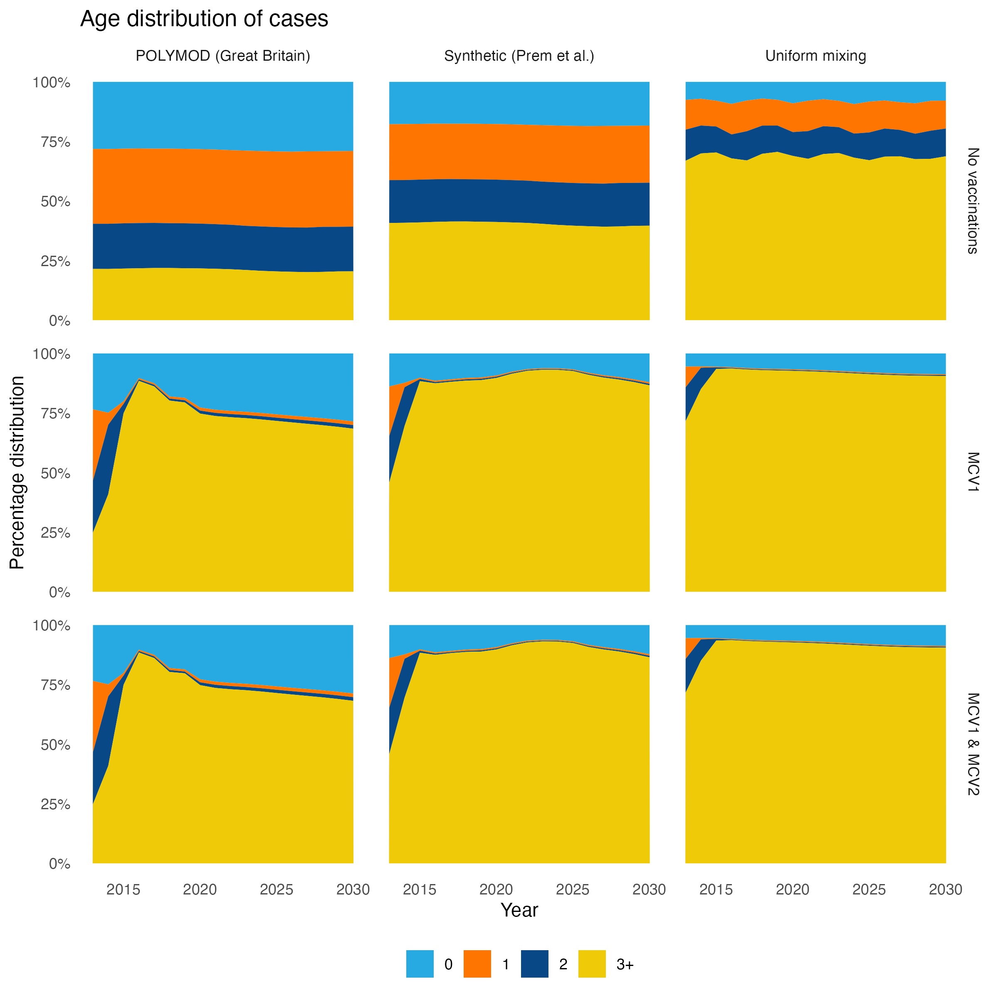
The effect of the choice of the contact matrix on age distribution of cases:
Substantial difference between the age distribution produced by the different contact matrices.
The (MCV1) and the (MCV1 & MCV2) scenarios suggest that the 3+ have the highest contribution to measles burden.

Slide 13
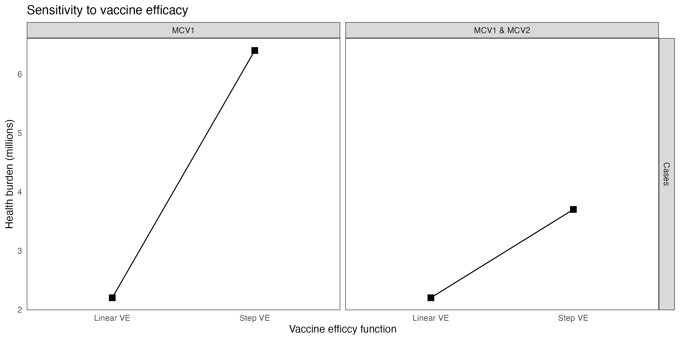
The effect of the choice of vaccine efficacy function on the health burden of measles
There is a substantial difference in cases, to suggest results depend on the vaccine efficacy function.

Slide 14
Results
(County)

Slide 15
Further assumptions:
Target Basic reproductive number fixed at 14.25 for all counties – the national value.
The national contact matrix is assumed to apply to all counties.
National CFR is assumed to apply to all counties.
The county-specific life expectancy is assumed to be equal to the national.
First dose efficacy is assumed as the national one.
___
The MCV1 & MCV2 Coverage are expected to grow by an absolute 1% every year from 2024-2030.
Scenarios:
- No vaccinatons (the baseline)
- MCV1 Only
- MCV1 + MCV2
MCV Vaccination impact metrics:
New infections (incident cases)
Measles related deaths:
Deaths = CFR * Cases
Disability adjusted life years:
k * [Cases – Deaths] + [Deaths * Remaining Life Exp.]
(Disability weight) k = 0.002

Slide 16
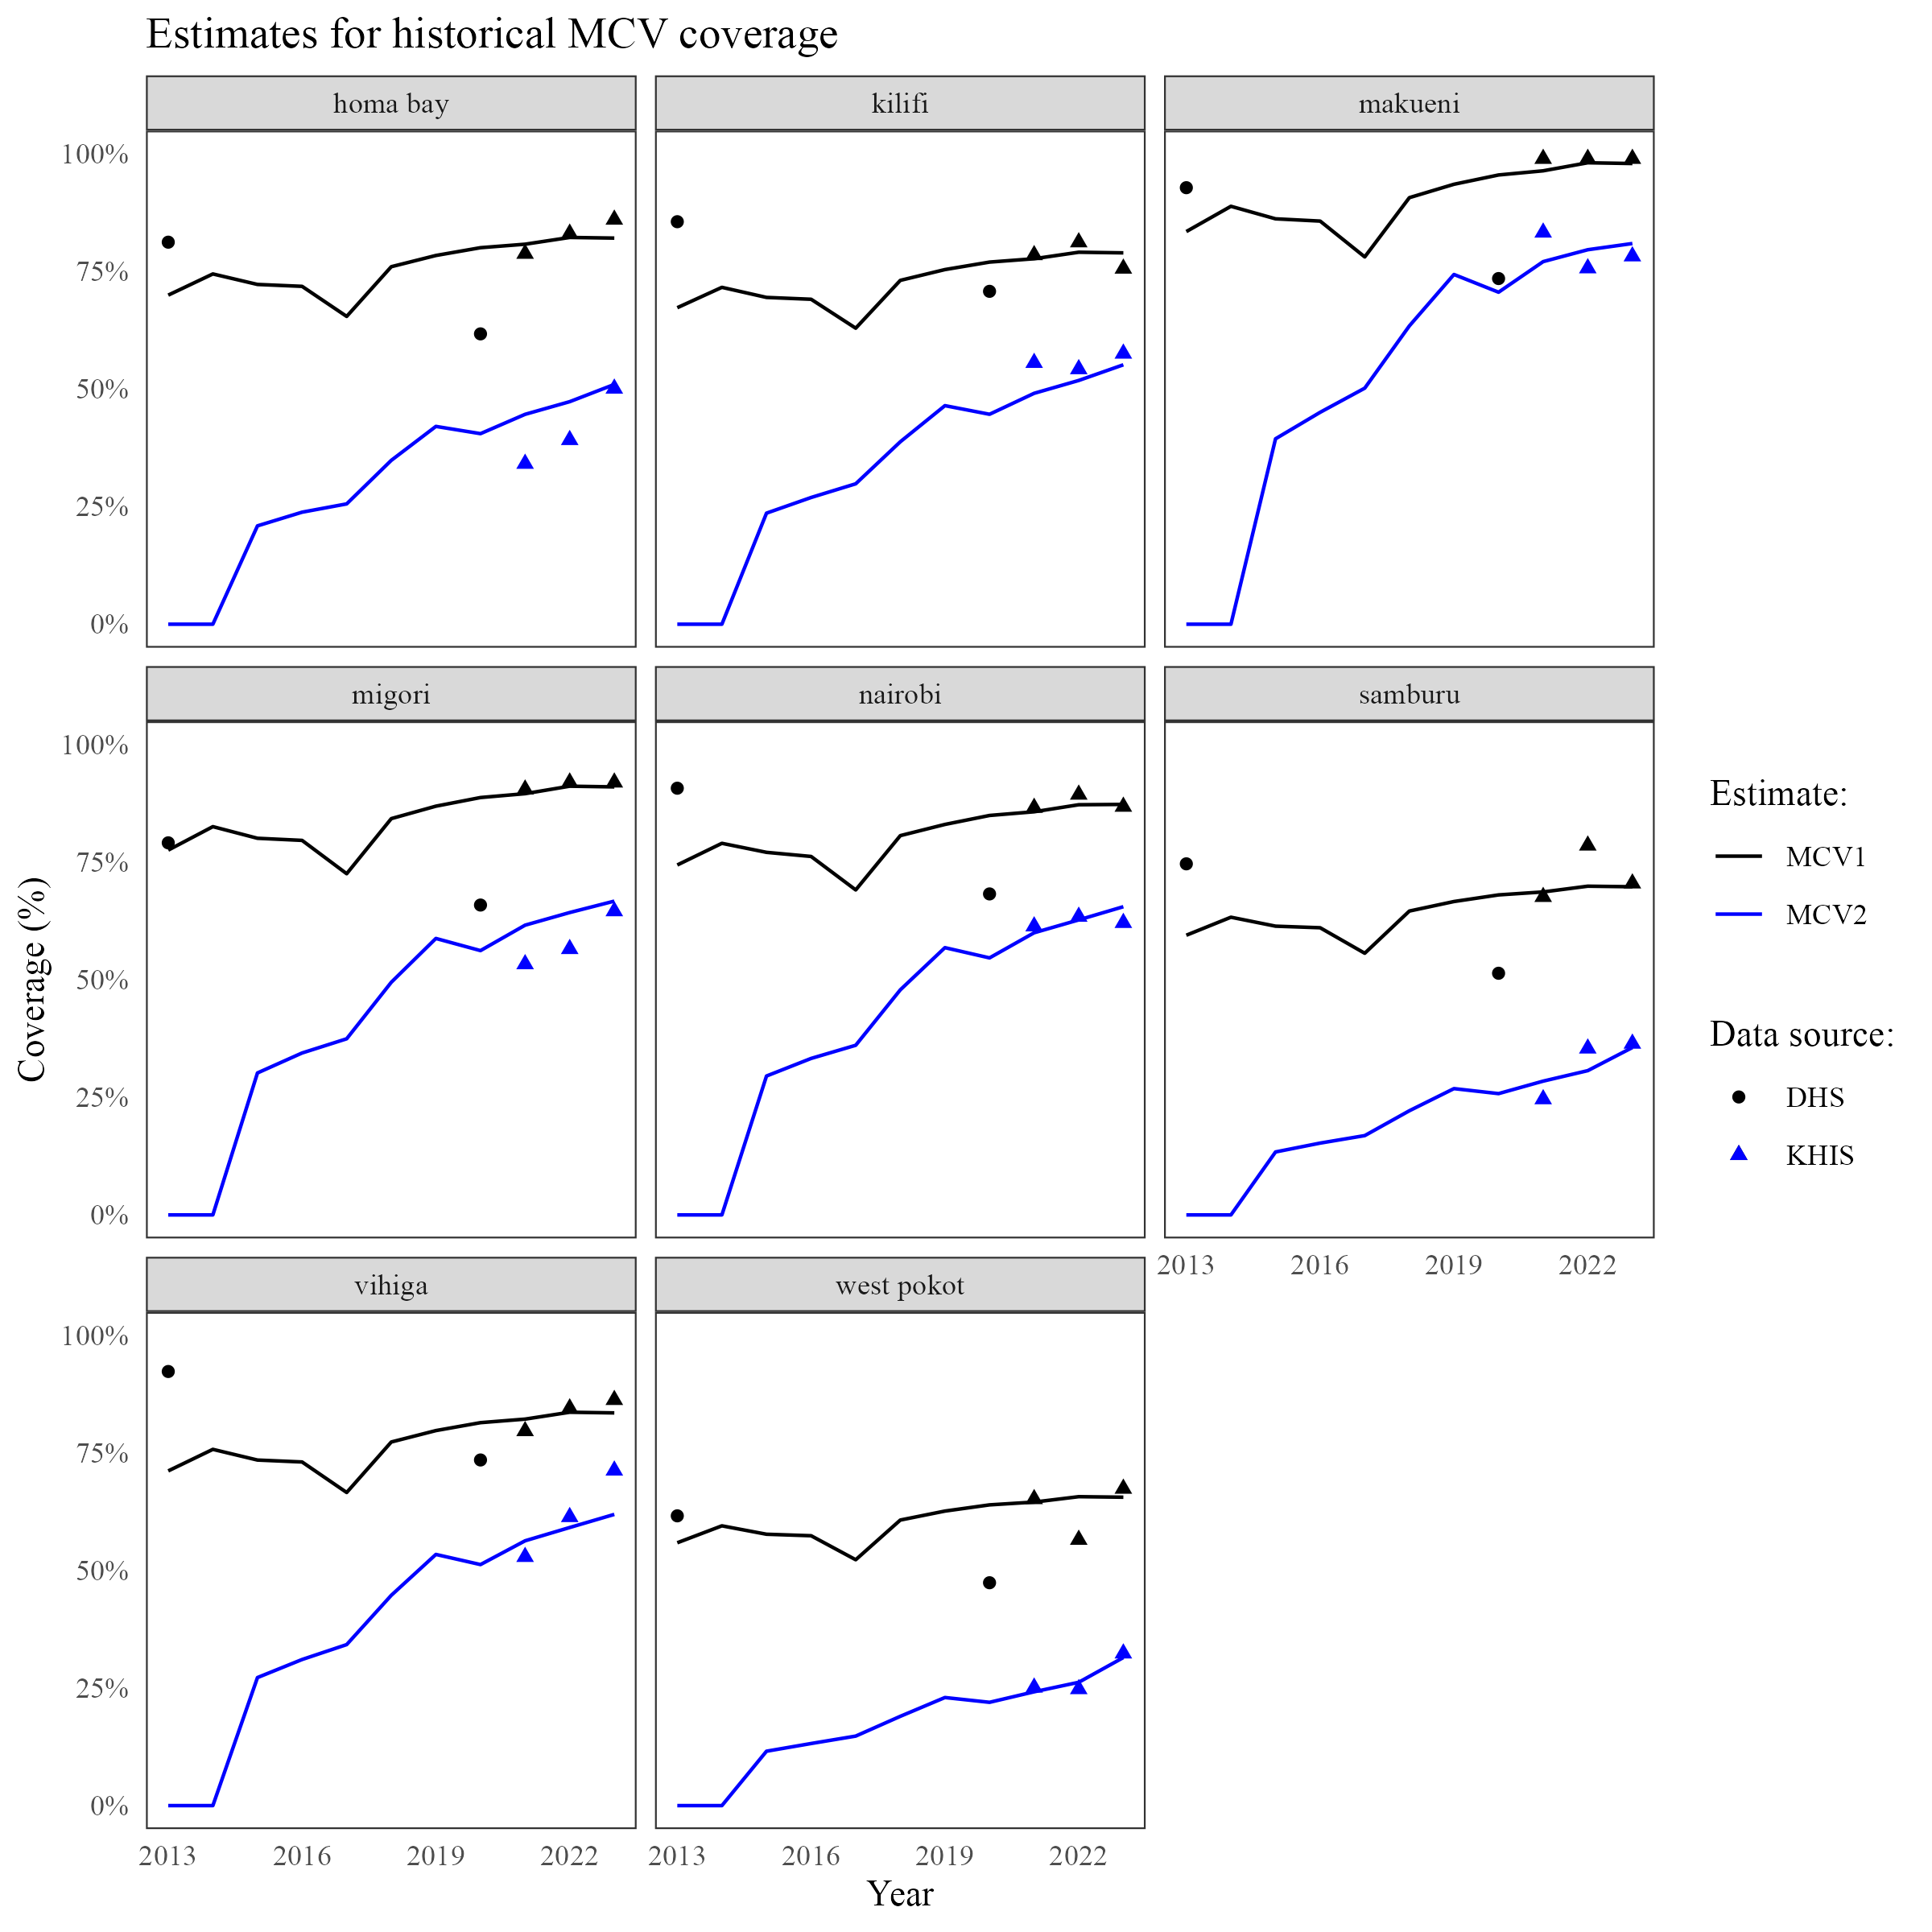
Historical MCV coverage at county-level:
(8 select counties)
Estimated using Dasymetric redistribution.
The MCV1 target population is (9-12 months) while MCV2 is (12-24 months).
The age-region distribution of population from 2013-2030 is assumed to be the 2019 KPHC age-region distribution.
County MCV1 is estimated using the relationship of MCV1 at county and MCV1 at national.
County MCV2 is estimated using a weighted equation of national relationship of MCV1-MCV2 & county MCV1-to-MCV2 ratio.
___
KNBS and ICF. 2023. Kenya Demographic and Health Survey 2022.
Nairobi, Kenya, and Rockville, Maryland, USA: KNBS and ICF.
Kenya Health Information System, 2024. Accessed: Fri 13 Dec 2024

Slide 17
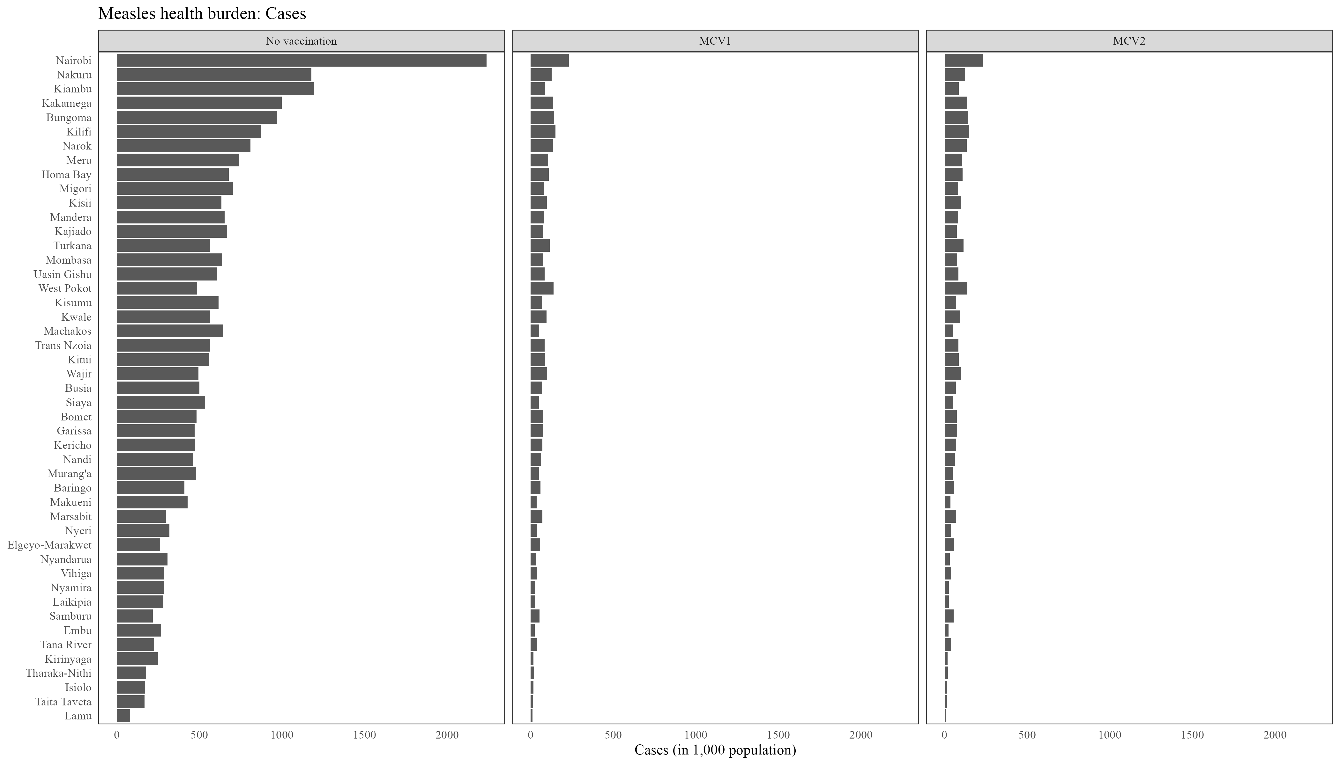
Cumulative measles burden (Cases): 2013-2030

Slide 18
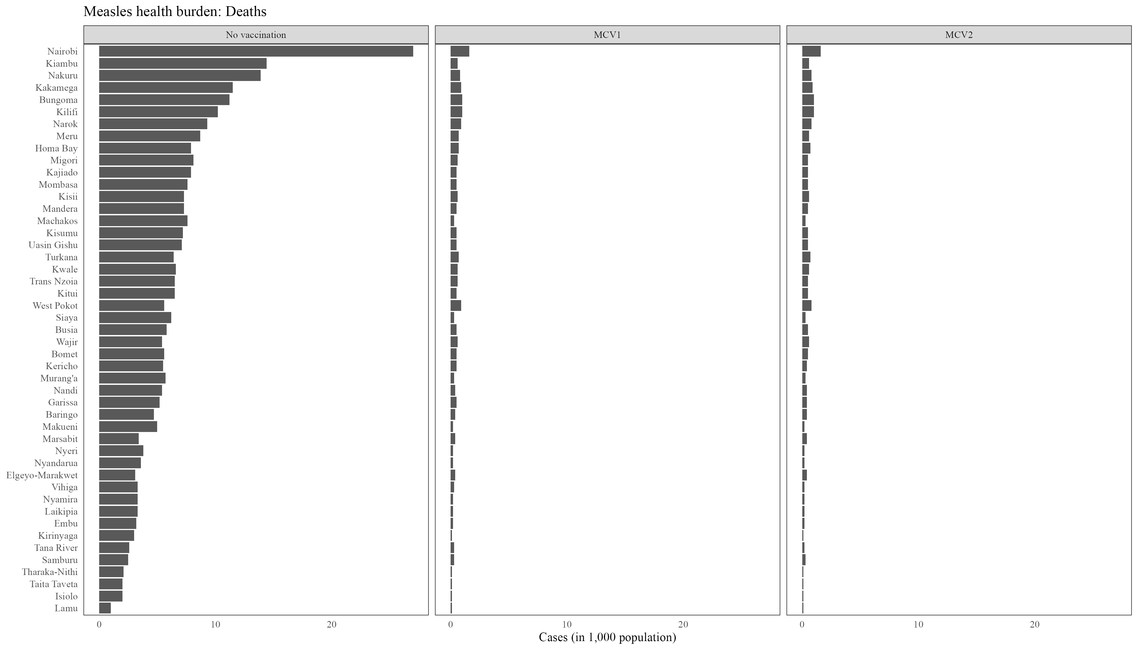
Cumulative measles burden (Deaths): 2013-2030

Slide 19

Cumulative measles burden (DALYs): 2013-2030

Slide 20
Refer to attached county table

Slide 21
Discussion

Slide 22
To update
Review
The national model, needs an additional scenario (MCV1 & MCV2 & SIA), coming when I find SIA data.
The social contact matrix from Kilifi HDSS (although rural only) can be incorporated.
Vaccine timeliness (whether the vaccine is given at exact 9 months) data can be updated, based on surveys (e.g. DHS).
Vaccine efficacy at county level can be informed by other factors such as malnutrition rates.
The sensitivity of results to the determinants e.g the contact matrix, and the specific vaccine efficacy function need to be investigated.
The model’s fit to data (incidence & age-distribution) needs to be investigated.
The model’s intialization states need to be updated with age-specific case data.
On whether the model takes into account that older people likely received vaccines, as well as immunity derived from past infections needs to be investigated.
Intra-county migration can be incorporated statistically, or in the mathematical model.

